Slide 1
Sound Formation

Slide 2
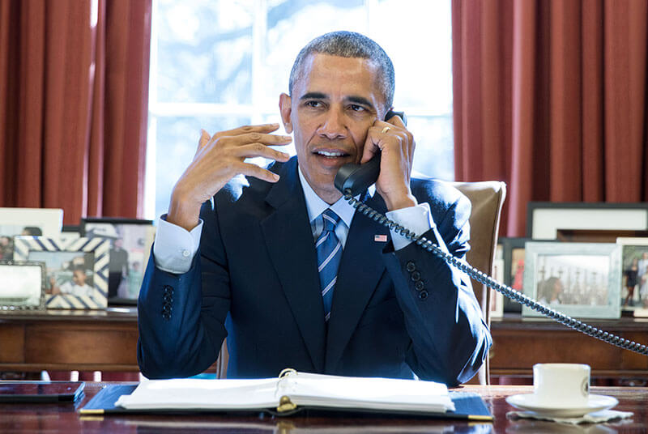
By the end of this Smart Lesson, you should be able to:
1. | State how sound waves are formed.
2. | Describe how the particles in a medium are affected by sound waves.
3. | Outline why sound can't travel through space.

Slide 3
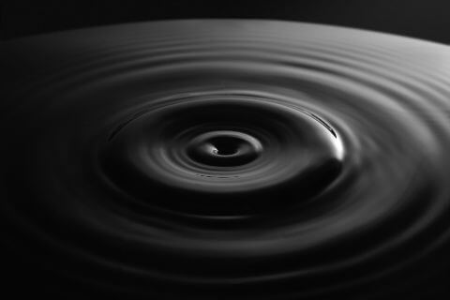
Sound is produced by vibrating objects.
The vibrating object causes the air surrounding it to vibrate.
You make sound when your vocal cords vibrate!

Slide 4
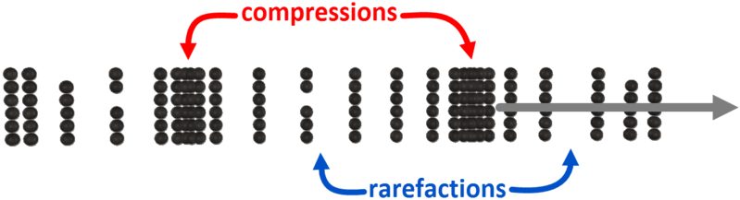
When air vibrates it causes the particles to either bunch together or spread out.
When the particles are bunched together we say that it is a compression.
When the particles are spread out it is called a rarefaction.

Slide 5

Sound waves are mare up of compressions and rarefactions.
A sound wave is a series of compressions and rarefactions which moves away from the vibrating object.
Sound is a longitudinal wave. This is because the particles vibrate in the same direction that the wave travels in.
This animation shows how longitudinal waves are made up of compressions and rarefactions.

Slide 6

Sound waves must always travel through a medium.
A medium can be a solid, a liquid, or a gas - basically anything which has particles in it.
This is because sound waves are formed from moving particles, so if there are no particles there cannot be any sound.
For example, space is a vacuum. This means that there are no particles in space. Therefore, sound cannot travel in space.

Slide 7

The speed which a sound wave moves at depends on the medium it is in.
When the particles are closer together the sound wave will travel faster.
This means that sound travels faster in solids than liquids, and faster in liquids than gases.

